Slide 1
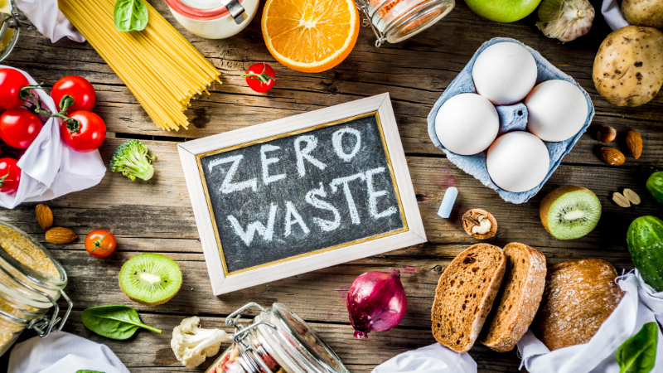
Food Waste Reduction Platform
Group 8 Members:
Yuan Lishu
Zu Haoran
Ye Yanni
Tang Yuan
Final Project - CST-8288
Lab Section: 033

Slide 2
Introduction
About the System: The Food Waste Reduction Platform (FWRP) addresses food waste by redistributing surplus food. It connects retailers, consumers, and charitable organizations to promote sustainability and reduce hunger.
Document Overview: A comprehensive guide to the design and implementation of FWRP, including solution architecture, technologies, UML diagrams, database models, and deployment models.

Slide 3
Teamwork
Yanni Ye: Overall code implementation; high-level document writing
Haoran Zu: Front-end design, code integration, project management
Lishu Yuan: Database design, front-end design, implementation of subscription and alert features, assisted with code implementation
Yuan Tang: High-level UML diagram design, assisted with food item-related code implementation, wrote Javadoc
Collaboration Method:
Met four times a week. Progressed the project through various methods such as task division, modular writing, and relay writing. Used GitHub for code uploading and merging.

Slide 4
Solution
How did you put everything together for your project?
Task division, GitHub uploading, merging, and debugging together; this process is repeated in cycles.
Use of any external libraries? Certainly!
Commons-dbutils-1.8.1.jar
Druid-1.1.12.jar
Servlet-api.jar
Mysql-connector-j-8.3.0.jar
Design pattern:
Singleton pattern
Data Access Object (DAO)
Observer
Junit and Code coverage
Ensures the functionality of individual components by isolating and testing each unit of code.
Code coverage: Core functionalities like user registration, inventory management, and alert systems.

Slide 5
Version Control System
Utilize GitHub:
GitHub repo link: https://github.com/LishuYuan0512/JavaProject
Different functionalities of GitHub
Each team member created a separate branch in their IDE to push their own code and write comments to commit(clarify the process).
Create a new branch to merge the code, team members cloned the combined code to continue working on their parts and pushed the updates to GitHub.
Use old branch to check the version history and debug previous issues.
Branching Strategy
Easy Project Management: allow multiple developers to work together on a project from anywhere
Code Review: to review, develop, and propose new codes
Increased Code Safety: safely share and manage code and version

Slide 6
Challenges
Tests environment issues
Solution：
Add jar to provide simulated environment instead of connecting to database .
Using different IDEs led to code compatibility issues.
Solution：
The team leader unified the code on the NetBeans platform
Conflicts occurred when uploading code to GitHub.
Solution：
resolved by reviewing GitHub's history.
Use pull request to get code and merge in local IDE
Check main branch work in different IDEs

Slide 7
Demo
Bonus Functionalities:
Implement a security check through user filtering.
Limitation and validation for user input data.
Functionalities to Demonstrate:
registration and login of different users
Customer pages: listing, pucharsing, subscription
Retailer page: add or modify of fooditem, marking items, received alert
Charitable Organizations: claiming item, purchasing.

Slide 8
Future Enhancements
validation process can be more rigorous.
For example, the same email should not be allowed to register with different identities.
Add a log file feature to help administrators debug the code more easily.
introduce more donor users who can donate food to the system such as restaurant or individual Donors.

Slide 9

THANK YOU
Group 8 Members:
Yuan Lishu
Zu Haoran
Ye Yanni
Tang Yuan
Final Project - CST-8288
Lab Section: 033

